Slide 1
How to write narrative CVs for funding applications
16 November 2023
Mary Muers (Medical Sciences Division)
Tanita Casci (Research Services)
Kanza Basit (Economics)
Susan Black (Careers Service)
Gavin Bird (Earth Sciences)

Slide 2
Today’s session
Why narrative CVs are being adopted by many funders
Overview of the narrative CV format
How to write:
  Where to start
  Tips for each module
  Example structure
Team CVs
Scheme differences and fellowships
Resources
Questions and discussion
Poll
What is your current level of awareness of the narrative CV?
How prepared do you feel to start writing your narrative CV?​

Slide 3
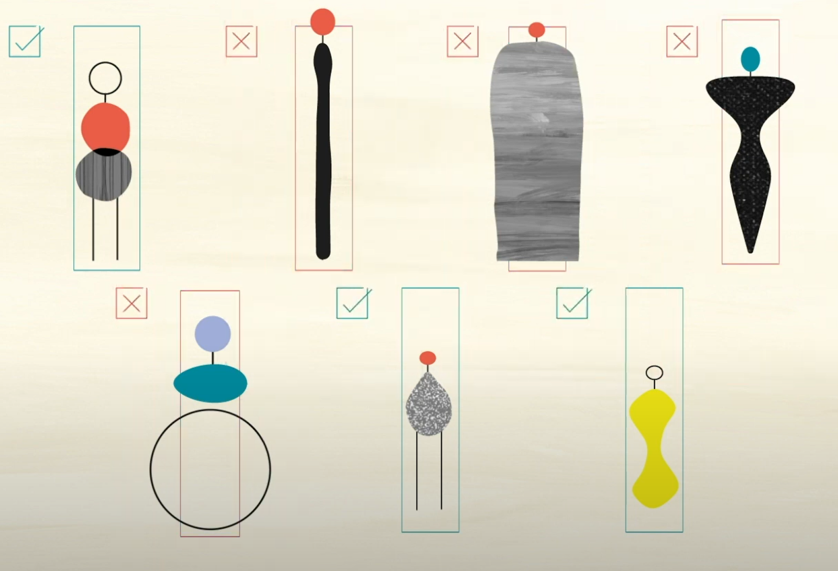
Research quality is too often assessed based on narrowly set quantitative indicators
Notes:
Research quality is too often assessed based on narrowly set quantitative indicators related to grant capture or publications, leading to a hyper-competitive environment and a poor culture

Slide 4

Publications
What we value in research
Invited talks
Awards & prizes
Successful grants
Leadership
Management
Integrity, openness,
transparency
Building collaborations
What research actually
involves
Team-working
Panels & committees
Inclusivity
Peer review
Participatory research
Mentorship
& supervision
Societal impact
Notes:
There is growing recognition that researchers should be rewarded for a broader set of activities that contribute to excellent research and innovation

Slide 5
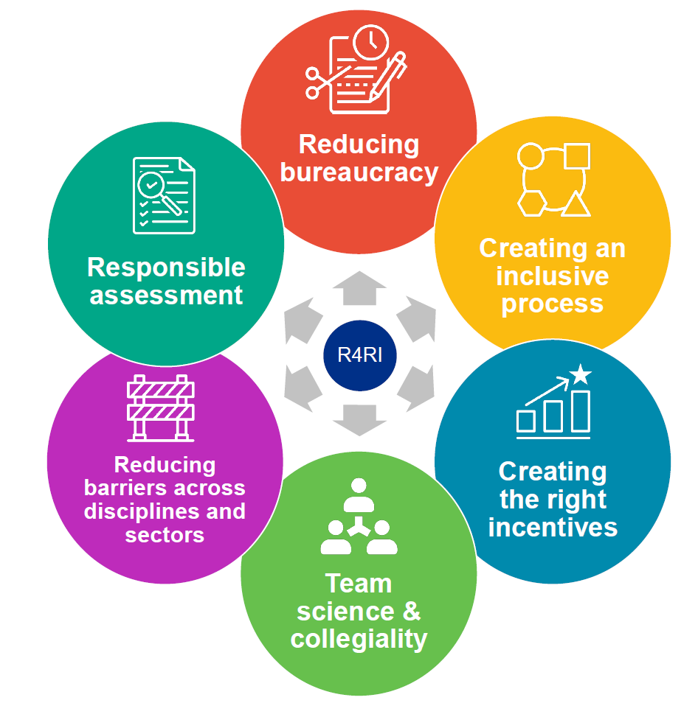

Narrative CV: diversifying what we value
The narrative CV provides a structured yet flexible format that prompts a description of contributions and achievements that reflect a broad
range of skills and experience.
Advantages
Rewards a broader set of activities
Values diverse contributions & career paths​
Improves diversity & inclusion​
Encourages responsible use of metrics
It allows you to tell your story
Image credit: UKRI
Notes:
Narrative CVs provide a structured, but flexible, format that is more inclusive of a wider range of contributions to research. It can allow for a better description of varied career pathways, and enables a broader range of people, ideas, and outputs to be highlighted.

Slide 6


Which funders?
UK Research and Innovation
Wellcome Trust
Royal Academy of Engineering
NIHR
Cancer Research UK
British Heart Foundation
Alzheimer’s Research UK
Leverhulme Trust
Science Foundation Ireland
Health Research Board, Ireland
Academy of Medical Sciences
Swiss National Science Foundation
Wellcome Sanger Institute
And more…!
https://www.ukri.org/what-we-offer/supporting-healthy-research-and-innovation-culture/research-and-innovation-culture/joint-funders-group/

Slide 7
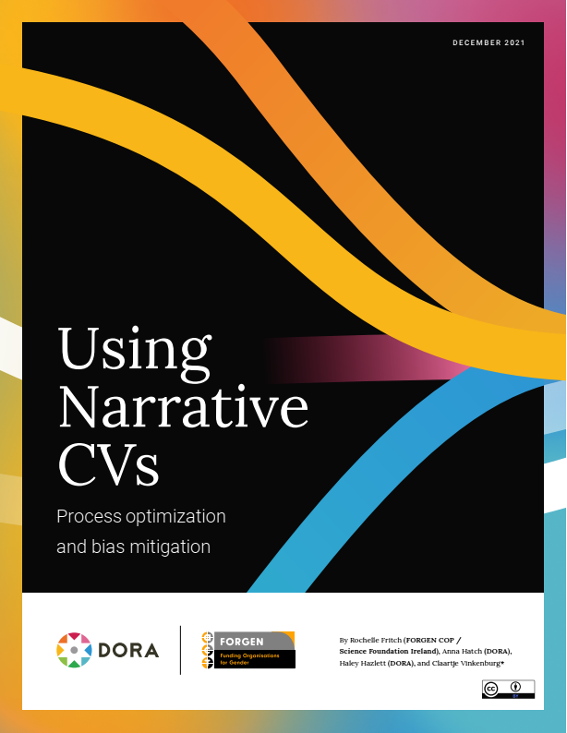
Wider use of narrative CVs
Universities are piloting the use of narrative CVs in recruitment
Same principles apply: recognising a broader range of contributions in research assessment, promotion, etc.
Notes:
Today, we are focusing on narrative CVs for funding applications – but worth being aware that there are some pilots of use of NCVs in recruitment
The underpinning principles of recognising a broader range of contributions and diverse career paths are being more widely used in recruitment, promotion, recognition processes in academia.

Slide 8
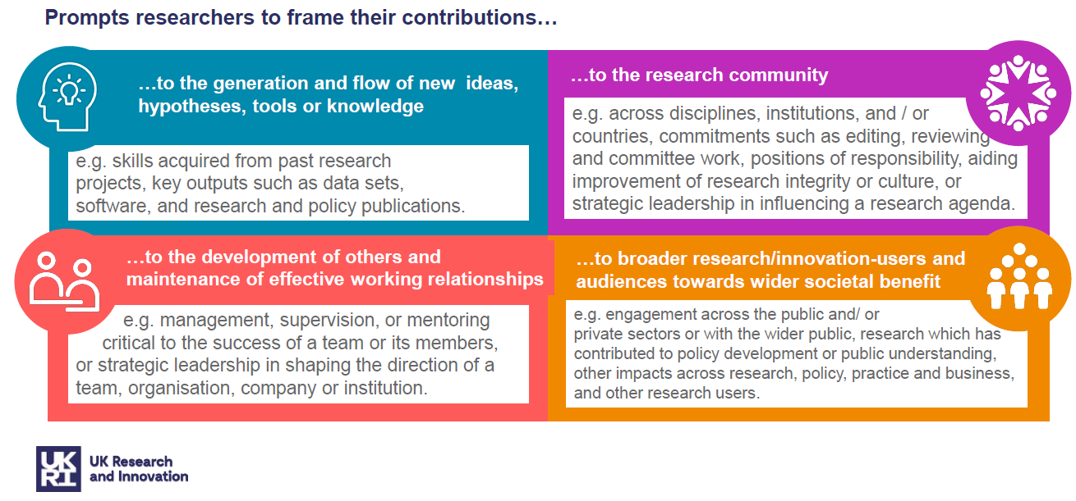




Narrative CV: key features
Researchers frame their contributions with respect to:
  1. The generation of knowledge
  3. The wider research community
  2. The development of individuals
  4. Broader society
https://www.ukri.org/apply-for-funding/improving-your-funding-experience/introducing-a-better-way-for-you-to-evidence-your-contributions/
Notes:
The most common format for NCVs asked for by funders is based on 4 modules
The topics of these modules are generally consistent amongst funders; the example shown here is from UKRI
Each module asks the applicant to describe their contributions
The four module topics are: ….

Slide 9
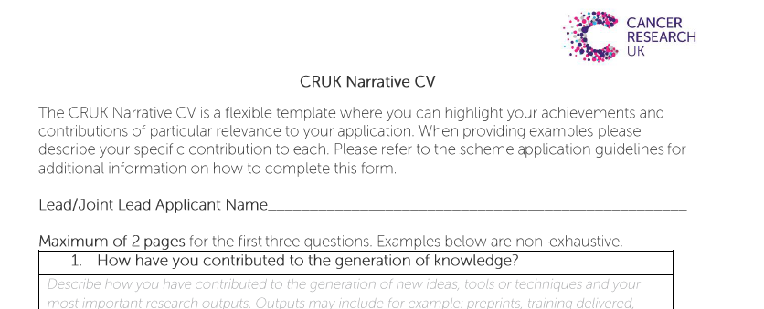
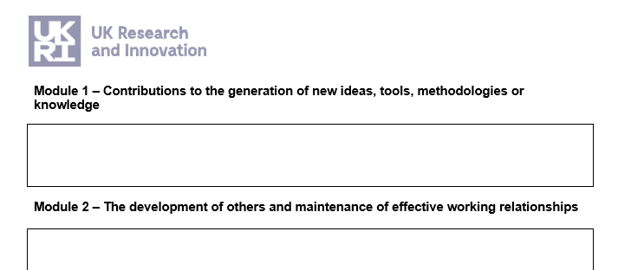
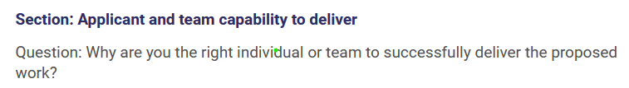
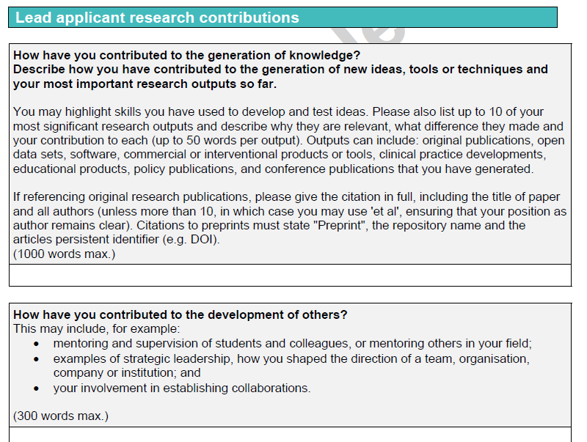
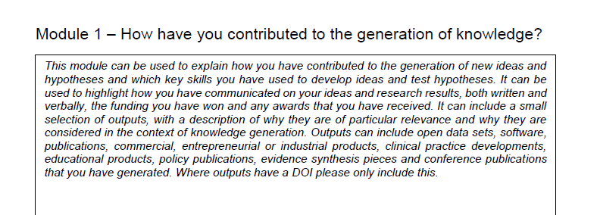
What does a narrative CV look like?
CRUK
UKRI
Royal Society
Wellcome
Notes:
Although the topics of the modules are largely consistent amongst funders, the forms or templates provided by funders can look a bit different.
Here are some screenshots to give examples (detailed text won’t be visible on the screen for participants)
Left: Cancer Research UK template; Royal Society template (in these examples the funder has put a bit of explanatory text for applicants in the template);
Right top: UKRI – until recently they provided a Word template with sections for each module, but on the new Funding Service online system they provide a question, usually entitled “applicant and team capability to deliver”, or similar, and ask the applicant to write their NCV with the module headings in a text box.
Right Bottom: Wellcome don’t call it a narrative CV but have questions closely related to the modules embedded in their ‘Lead applicant research contributions’ section.

Slide 10





Where should I start?
Check the funder instructions and template
Download the Guide developed with research support professionals in Oxford
Allow time: it will take a day or more to write your first narrative CV
Notes:
Note that it might feel daunting, suggest that people take some time to familiarise themselves with what their funder is asking for and also the Guide that can be downloaded from Oxford’s NCV webpage

Slide 11
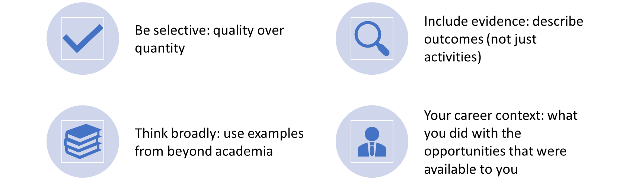
Principles for writing a Narrative CV
Early career?
Don’t worry!
Assessors will look at the CV as a whole and consider career stage
Try to have something in every section, but don’t worry if you can’t
Notes:
Before getting into details of what could be included in each module, we’d like to highlight some principles:
Don’t overwhelm reviewers with long lists, or dilute the communication of your key achievements.
Think about your strongest contributions, and those that are most relevant to the funding call you are applying for.
Focus on what you have achieved rather than what you plan to do in the future.
Provide evidence: When choosing material to include, think about how you are going to evidence quality and importance. Describe outcomes, and how you enabled them, rather than just stating activities. You can include both qualitative and quantitative evidence.
Provide context: Unlike a traditional CV, a narrative CV allows you to explain how the activities enhanced your skills or were important at your career stage, and the rationale for undertaking those activities.
Question: I am at an early stage of my research career and I don’t have many examples to include. What should I do?
Answer: The assessors should take your career stage into account. State how long you have been working in research or in a particular field or role, so it is easy for them to assess your achievements in context. You could use examples from outside of academic research, such as leadership or mentoring others in a different sector or a voluntary context. It is OK for some Modules to be short or empty.
Evaluation: Your narrative CV will be used to inform the overall assessment of a proposal or application. Assessors should not be asked to score individual modules. Therefore, leaving a module empty or with little information should not be detrimental. The balance of material in a CV will look different depending on discipline or career stage.

Slide 12
Module 1: generation of new ideas, tools, methodologies or knowledge
Your outputs, e.g.:
  Research publications (may include thesis)
  Policy publications, conference publications
  Data sets, software, code, protocols, materials
  Products (e.g. commercial, entrepreneurial, industrial, educational)
  Evidence synthesis
  Patents, designs
  Artefacts
  Exhibitions, audio or visual media
Development of methods, tools or resources
Generation of new ideas and hypotheses
Funding
Awards you have received or other forms of peer recognition, such as invited talks.
Save space
Use digital object identifiers (DOIs)
Remember to describe
Your specific contributions to each output (e.g. CRediT)
How your involvement in an output came about
Avoid
Uninformative metrics e.g. productivity or journal-based metrics (e.g. impact factors), when describing the quality of your track record
Notes:
the lists provided here of types of contributions you can consider for each module may not be exhaustive, and also that you are not expected to have made all these types of contribution.

Slide 13

Evidence, not lists
“Since 2015, I have published 6 first-author articles, mainly in high-impact journals.”
vs
“My research has contributed to a revised understanding of [phenomenon / observation A] through an in-depth an︎alysis of the effects of [B & C] on health outcomes. The work is reported in the pre-registered and openly accessible output [D; doi]"
This Photo by Unknown Author is licensed under CC BY-SA-NC

Slide 14
Module 2: development of others and maintenance of effective working relationships
Supervision or mentoring
Project management or line management, critical to the success of a team or team members.
Strategic leadership shaping the direction of a team, organisation, company or institution.
Formal teaching could be included if it focused on the development of others and is relevant to your application.
Establishing or driving collaborations or networks; contribution to team-working.
Provision of development opportunities including training, events, rewards, or recruitment strategies.
Early career?
Even if you didn’t have a leadership role, how did you contribute to the success of a team or the development of others?
Supervision or mentoring
Go beyond a number, e.g. how did you help people to develop and what did they go on to achieve?
Notes:
the lists provided here of types of contributions you can consider for each module may not be exhaustive, and also that you are not expected to have made all these types of contribution.

Slide 15
Module 3: wider research and innovation community
Activities across disciplines, institutions, and/or countries
Editing and reviewing
Committee work within your organisation and beyond
Positions of responsibility
Activities that have contributed to the improvement of research integrity or cultures, including equality, diversity and inclusion practices
Influencing a research or innovation agenda
Contributions to professional bodies
Organisation of community events, such as conferences or workshops
Contributions to open research, active sharing of knowledge and skills, community resources
More than a list of roles
Describe the importance of your contributions to the community and your career
Module 3 vs Module 4
Contributions to wider society go in module 4
Notes:
the lists provided here of types of contributions you can consider for each module may not be exhaustive, and also that you are not expected to have made all these types of contribution.

Slide 16
Module 4: broader research/innovation-users and audiences and towards wider societal benefit
Actions to ensure that research reaches, influences, and involves relevant audiences, eg via:
  Knowledge exchange, bringing together researchers, users of research and wider groups and communities to exchange ideas, evidence and expertise
  Policy engagement and development
  Partnerships with business, industry, healthcare, and so forth
  Public engagement with research and public understanding
  Patient and public involvement (PPI)
  Participatory research
  Responsible research and innovation
Where activities have led to societal benefit to:
  Economy, society, culture, public policy, or services, health, environment, or quality of life
Who benefitted?
Describe the beneficiaries, scale and depth
Check funder differences
This module may not be included; you could put examples elsewhere e.g. in 1 or 3
Notes:
the lists provided here of types of contributions you can consider for each module may not be exhaustive, and also that you are not expected to have made all these types of contribution.

Slide 17

Optional section: Additions
Describe factors that provide context
  e.g. Career breaks, impact of the pandemic, part-time working
Check funder guidance
May be seen by reviewers:
  Focus on how the issue has affected your career, and how you handled any challenges
Personal details
May be asked for in other sections of the application
Check the funder guidance
Personal statement
Only for some funding schemes

Slide 18
Example structure
Module X – Contributions to….
Summary sentence: The main message that you want a reviewer to notice
Strongest examples 1, 2, 3 etc. What you did and why it is important, with evidence. In paragraphs or bullet points.
…
…
Brief mention of additional contributions that are relevant
Worried about language?
Focus on stating what you have done and why
The examples are more important than the choice of words
Poll
Which module do think will be the most challenging to complete?
Notes:
Summary sentence: start with the main message that you want a reviewer to notice, or refer back to, which could be a unifying theme of the examples that follow.
Succinct descriptions of your strongest contributions: what you did and why it is important, with evidence. This could be in sentences or bullet points. You could group entries that are supported by the same evidence.
Sentence summarising additional contributions: end with a brief mention of other activities or contributions that you do not have space to describe fully but you feel are important for this funding application.

Slide 19
Writing a Narrative CV: step by step
Create a long list of activities you could include in each module OR
Work on one module at a time
2. Highlight the strongest and most relevant, referring to the funding call
3. Identify the significance and evidence for highlighted activities
4. Move examples between modules if needed
5. Draft a summary sentence to open each module: what do you want a reviewer to remember?
6. Draft the text for each module (see previous slide)
Notes:
Using the prompts in the template below, make a list of the activities you could include in each of the four modules.
In your long list, highlight the entries that are most relevant to the funding call.
For each of your highlighted entries, jot down evidence of their significance: this could be quantitative (e.g. ‘this was the largest collection of its type’) or qualitative (e.g. quotes). Referring to your funding call might help you to identify your strongest activities.
Check for overlap between the lists in each module, and move any entries that fit better in a different module.
Look at your selection for each module and think of the most important point that you would want a reviewer to remember. Try to summarise that point in a sentence or phrase.

Slide 20

Team CVs
A single narrative CV for a team, e.g. used by UKRI
Download the guide to suggested steps for team leads
Skills and experience needed – collectively – by the team to deliver the project, i.e. a ‘showcase’
Structure by theme rather than person-by-person
Roles within the team: show how the individuals contribute
  E.g. Successful leadership of complex or collaborative projects by the Project Lead(s)
  E.g. Strong examples of supporting career development by Training Lead
  E.g. Contributions of team members at earlier career stages
Focus on what is needed for the specific project
The best examples may not be the default ‘top’ achievements from the standard academic CVs
Image credit: Nick Youngson CC BY-SA 3.0 Alpha Stock Images
Notes:
Introduce the idea of a single team NCV
Principles of showing the team’s collective strengths and capabilities, rather than focusing on each individual in turn

Slide 21
Scheme-specific differences to look out for
Length limit variations – check carefully
Some funders do not include Module 4 (broader impact)
Metrics, e.g. may allow citations but not altmetrics
Hyperlinks, e.g. do they want hyperlinked DOIs or does format remove links?
Asking for ‘future’ as well ‘past’ e.g. Science and Technologies Facilities Council fellowship
  “Have identified opportunities to access career development support…” (Module 2)
  “Describe how you would communicate and disseminate your research outcomes …” (Module 3 and Module 4)
E.g. NERC Pushing The Frontiers (Jan. 2023)
  •“the panel members were looking for a clear statement of what your research needs are and how you will deliver those requirements within the proposed project (with reference to previous experience/record as required)”
  •“The panel commented that this was slightly backward looking in that it pointed to past successes rather than how the team would deliver these elements in the future”
Notes:
Length limit might be given as a number of pages or as a number of words.

Slide 22
Advising fellowship applicants
Context - Fellowship applications – NERC Independent Research Fellowships (2022, 2023); STFC Ernest Rutherford Fellowship – 10 applicants
Competitiveness – consider the weighting attached to the Capability to Deliver
A quiet word with panellists or reviewers
Watch for changes in word count – 1,000 in 2023, 2,000 in 2022
Make sure applicants share drafts of material in good time (Funding Service obstacle!)
Applicant career stage will be recognised by reviewers, but try to add something rather than leave gaps, wherever possible
Influence and contributions beyond academia – outreach and engagement with schools, the public, etc. (especially given the non-specialist backgrounds of reviewers)
What have you done or what will you do with the funders’ (public/charity) money? Be as outward looking as possible

Slide 23

FAQ
Is the Narrative CV here to stay?
Probably yes, both nationally and internationally. UKRI have indicated that they will use the Narrative CV in all funding schemes from early 2024.
Does all the Narrative CV need to be provided in prose?
No, it is fine to include bullet points as well as full sentences.
How will the Narrative CV be assessed?
This varies by funder, but reviewers are asked to assess the CV as a whole
rather than individual modules.
Are there libraries of successful Narrative CVs?
Not at the moment, as it’s too early to identify good examples.
Also, exemplar CVs might encourage applicants to follow the model
descriptions rather than focus on documenting their individual track record.

Slide 24

Resources
University of Oxford Narrative CV webpage
  Writing guide
  Recorded webinar
  Q&A, and more
Research facilitators in your department or division
Your peers
Colleagues on funder review panels
Careers Service appointments
Other universities: e.g. University of Glasgow and University of Cambridge
Poll
What is your current level of awareness of the narrative CV?
How prepared do you feel to start writing your narrative CV?​

Slide 25
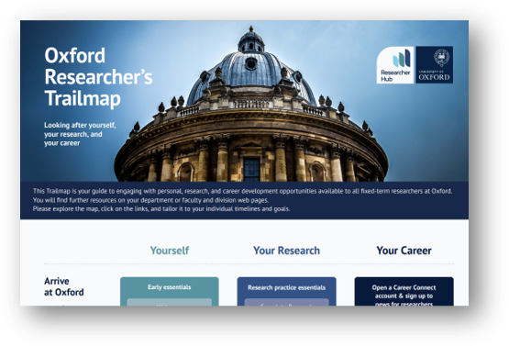

Strengthen your narrative CV
Professional development: Research staff are entitled to 10 days for professional development per year
Take a look at the Planning your Professional Development webpage
Ideas please!
Poll
What could researchers do to strengthen their narrative CV?
https://www.ox.ac.uk/research/support-researchers/researcher-hub/researchers-trailmap

Slide 26

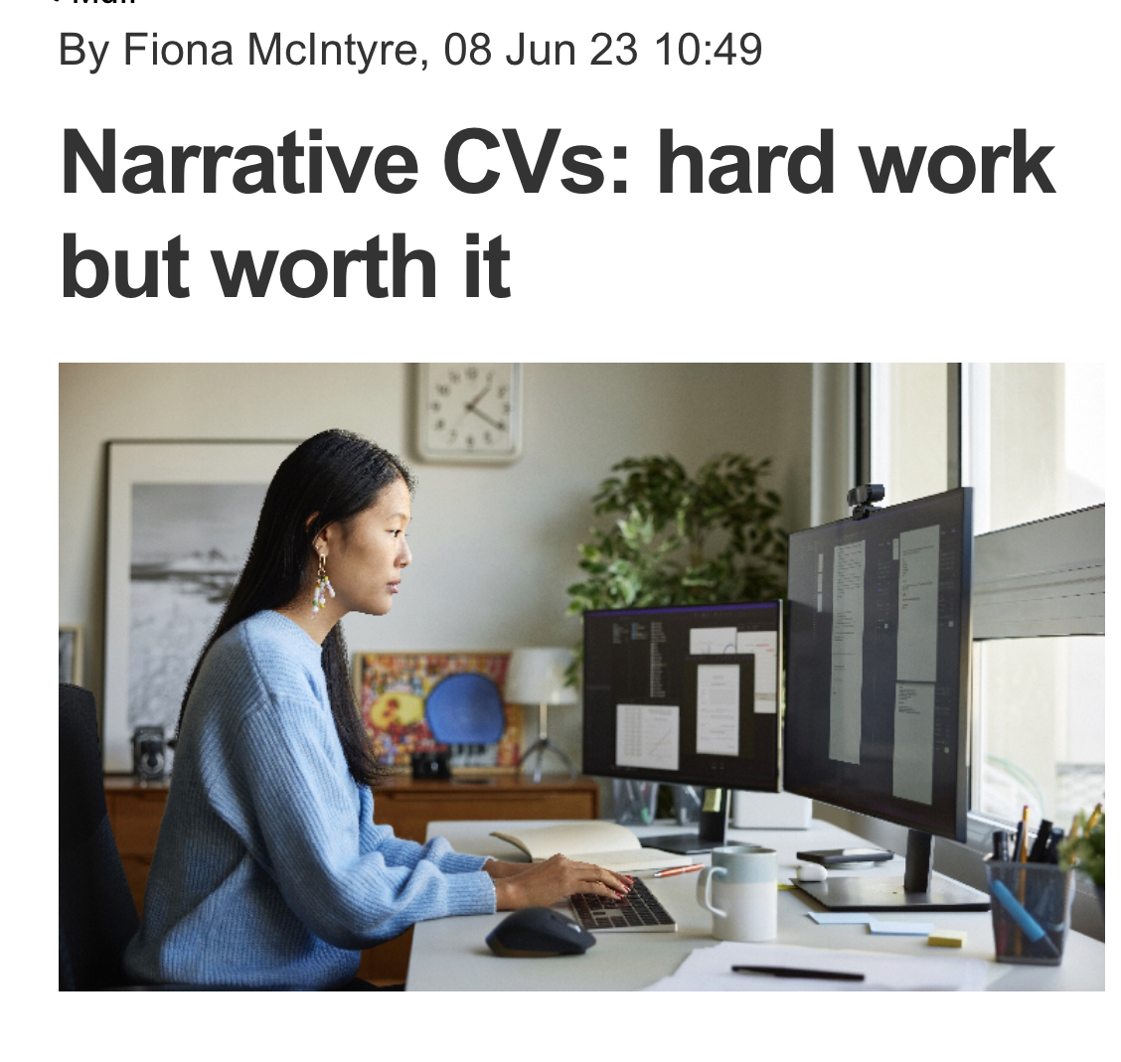
Questions and feedback
Feedback on the session, resources or webpage? Use this link to provide suggestions.
Research support professionals – are you interested in delivering training?
Contact us:
  Mary Muers mary.muers@medsci.ox.ac.uk
  Tanita Casci tanita.casci@admin.ox.ac.uk
  Careers service susan.black@careers.ox.ac.uk

