Slide 1
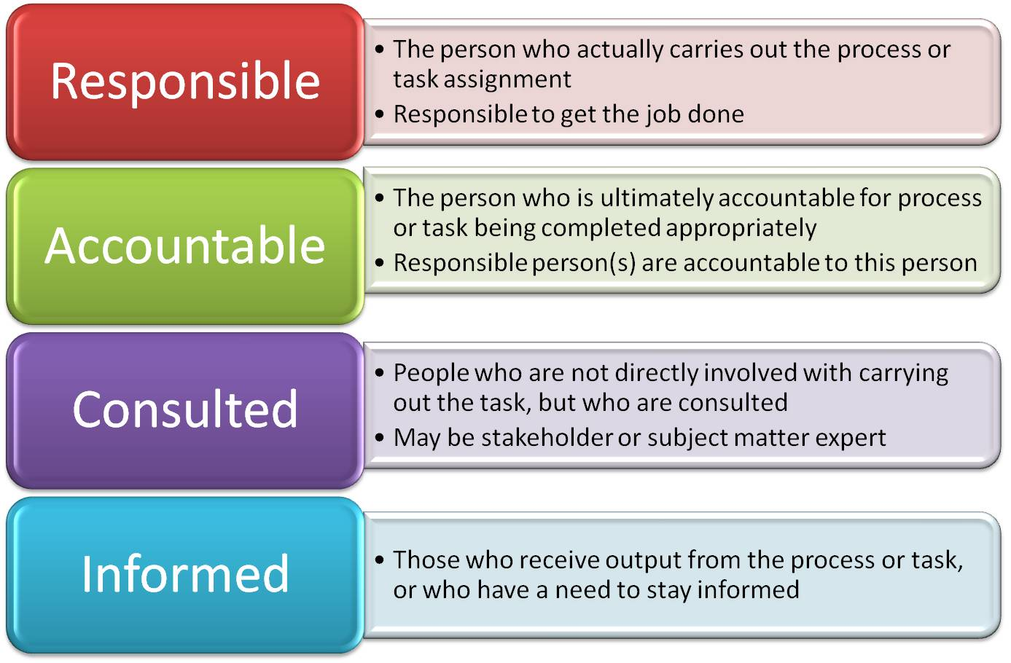
RACI

Slide 2
RACI – Title
Task/Process | Name/ Team 1 | Name/ Team 2 | Name/ Team 3 | Name/ Team 4 | Name/ Team 5

